Slide 1
Let’s have a talk
Electric Vehicles

Slide 2
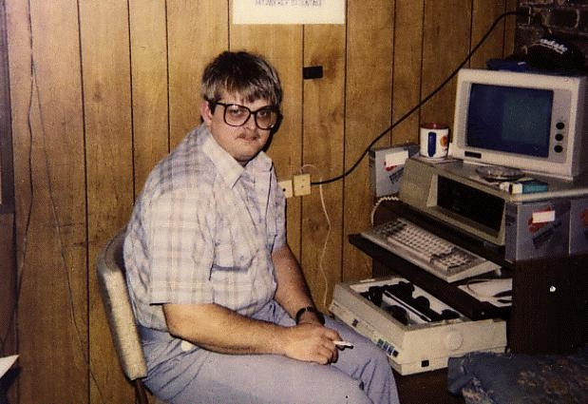
My Expertise
None
The Driven
Just have a think
ABC - Science & Tech
Autoblog
MIT News
The Guardian - Self Driving Cars
Lifehacker
CNBC
Nerd
Notes:
The Driven
Just have a think
ABC - Science & Tech
Autoblog
MIT News
The Guardian - Self Driving Cars
Lifehacker
CNBC

Slide 3
Vehicle Types
And some basics

Slide 4
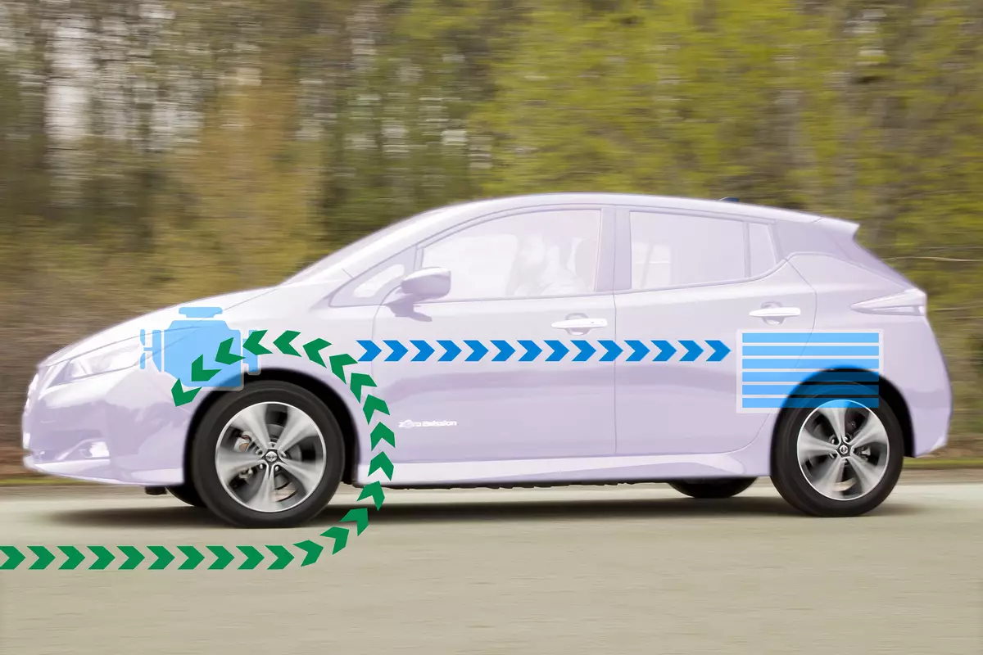
Regenerative Braking
Notes:
Blackheath - Near empty
Bottom of Victoria pass - + 50km range

Slide 5
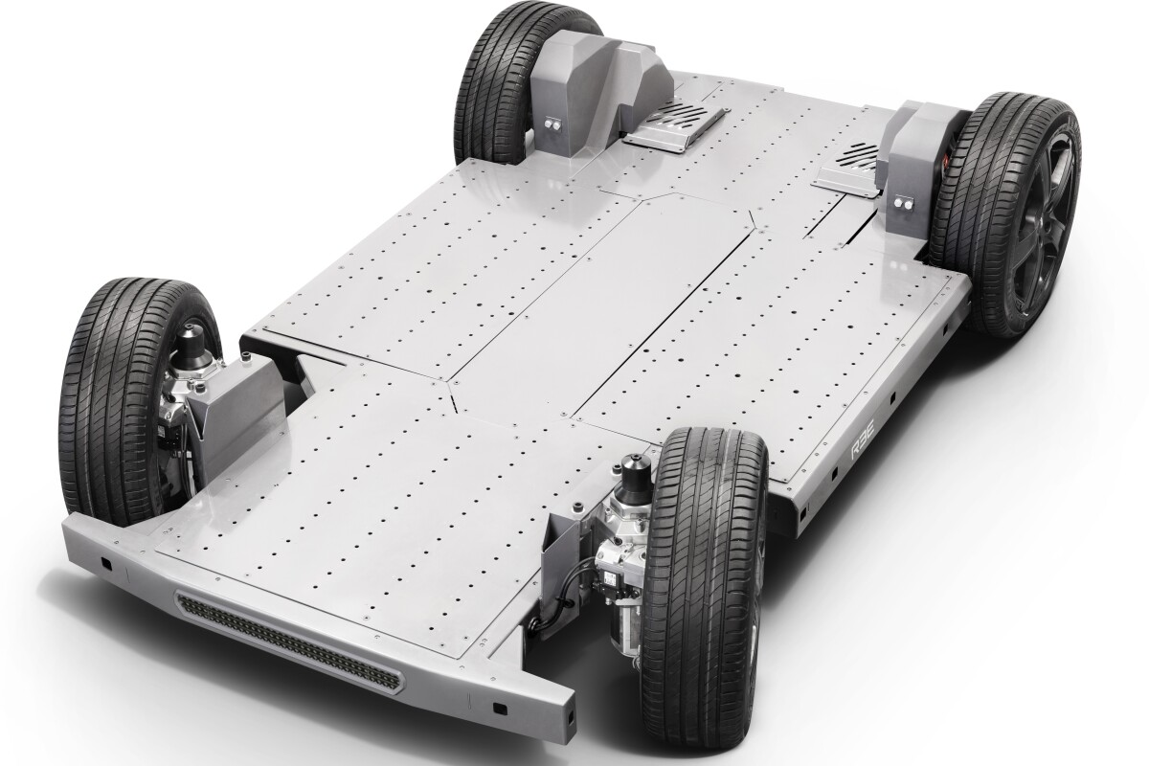
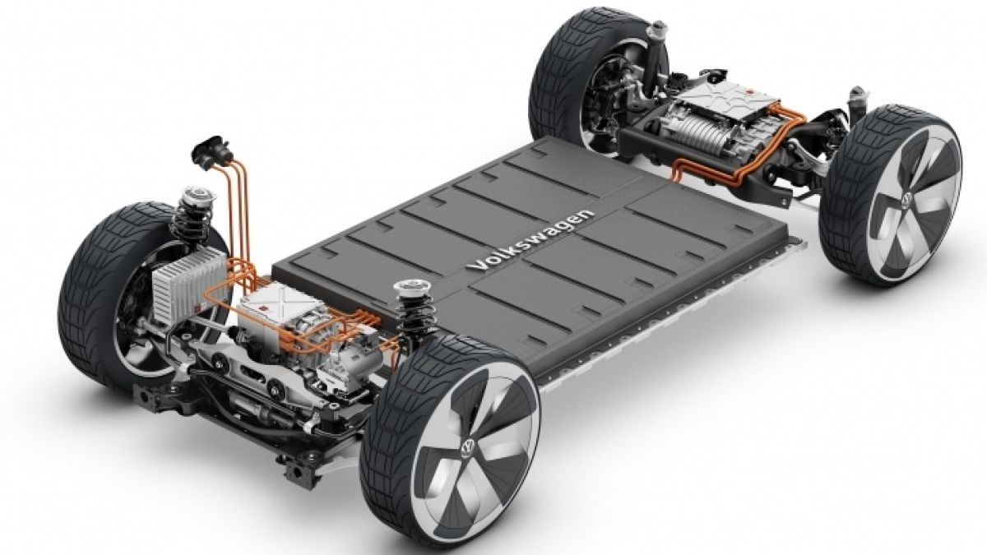
Construction

Slide 6
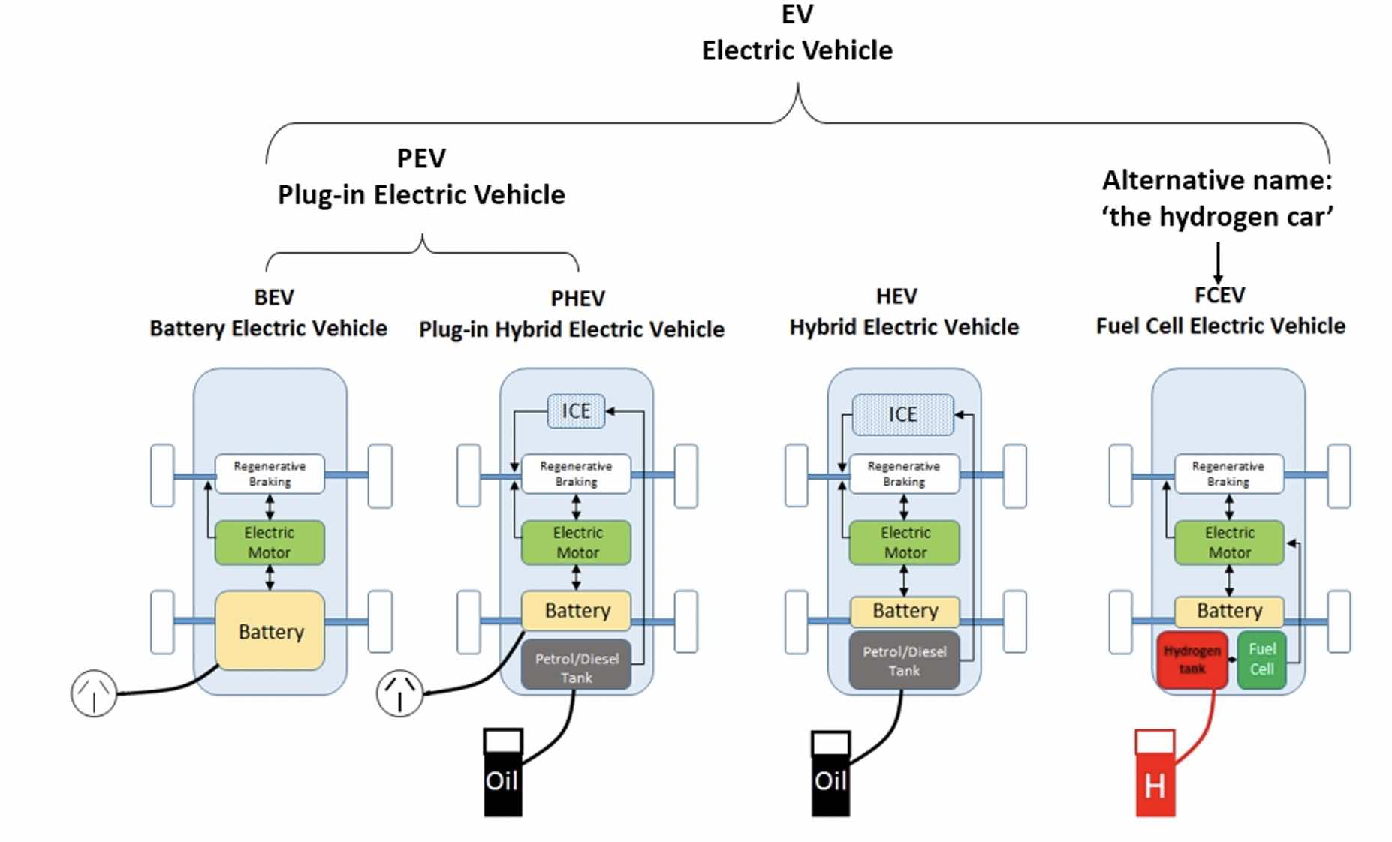
Car Types
ICE Internal Combustion Engine

Slide 7
When will all this happen?

Slide 8
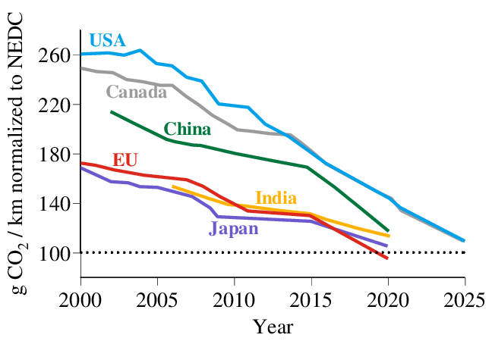
Wot’s Driving the Changeover to EVs?
Vehicle Emission Standards
AUS
Notes:
New European Driving Cycle

Slide 9
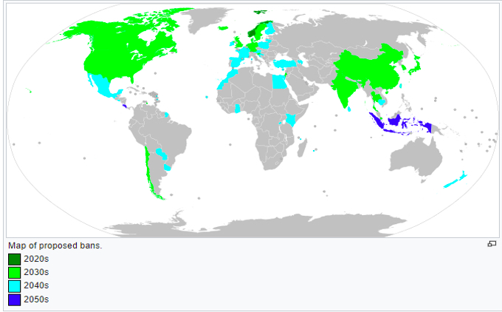
When ?
30 National Governments + BYD Auto, Ford Motor Company, General Motors, Jaguar Land Rover, Mercedes-Benz and Volvo | 2035 “leading markets” 2040 “Worldwide”
Mercedes-Benz | 2025
Jaguar | 2025
Volkswagen | 2026
Nissan’s CEO, Ashwani Gupta:
“... we’ve decided not to develop ICE engines, starting [from] Euro 7, for Europe.”
Brussels-headquartered campaign group Transport & Environment:
“... it’s expected that Euro 7 standards will be implemented in 2025”
CNBC 9/2/2020

Slide 10
Continuing ICEV Demand - Hilux?

Slide 11
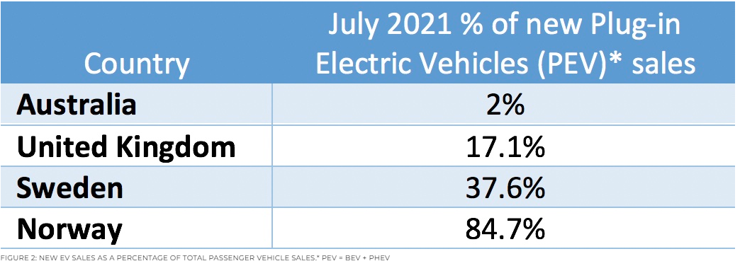

Slide 12
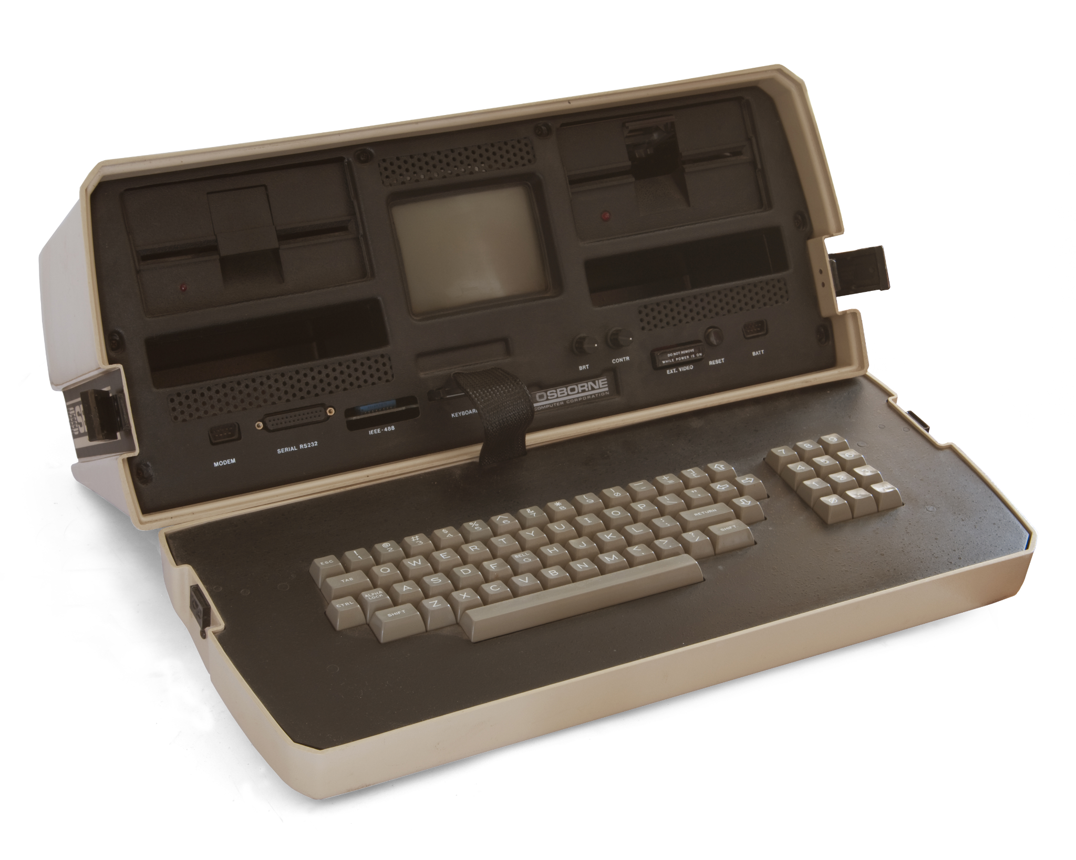
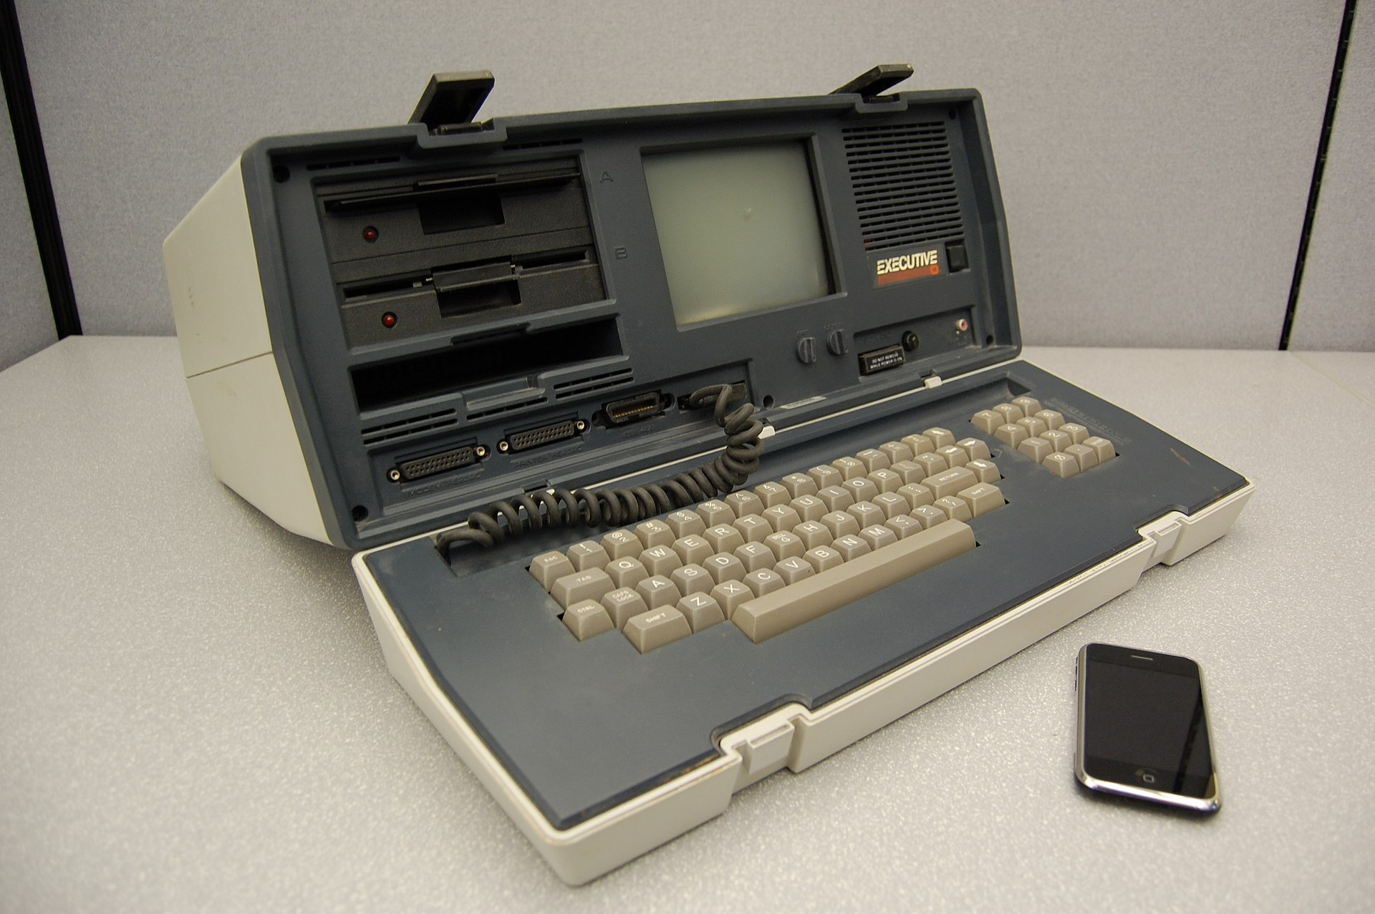
EV uptake maybe sooner than most pundits anticipate
Osborne effect (The Driven - 7 July 2020) ??
Osborne 1 (1981)
Osborne Executive
(Bankrupt 1983)

Slide 13
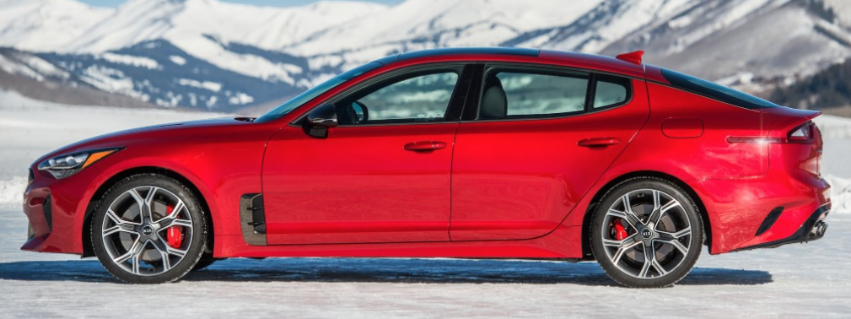
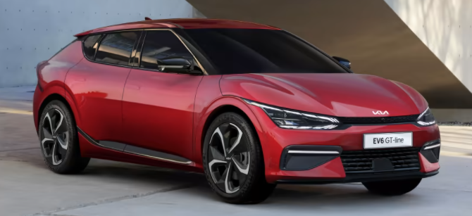
EV uptake maybe sooner than most pundits anticipate
“The initial batch of 240 Hyundai IONIQ 5 EVs sold out in just over two hours” (carsales.com - 12 October 2021)
“Never in my wildest dreams”: Kia Australia’s Damien Meredith amazed by huge interest in EV6 and speed of electric shift. (Driven podcast - 25/2/2022)
2017 Stinger - 10,000 EOI
2022 EV6 - 25,000 EOI 1,500 Firm Orders
Notes:
Damien Meredith quotes:
Stinger - 10,000 EOI EV6 - 25,000 EOI 1,500 Firm Orders 3 years to fulfill?
Could handle ~ 5,000 cars / year - getting ~ 500/year
EV6 $72k - $85k
End of decade - 50% EV on the road

Slide 14
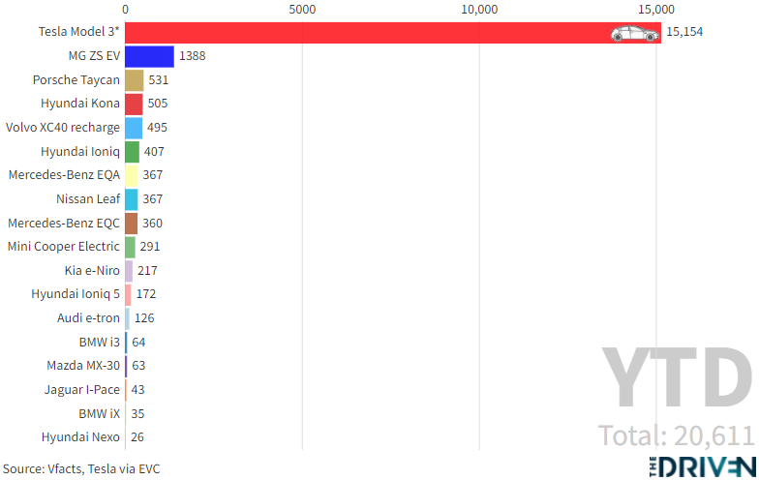
Australian BEV Sales 2021 (Available models)
12,000

Slide 15
New models for Aus 2022
Audi E-Tron S
Audi E-Tron GT
BMW i4 Medium car
BYD Yuan Plus
Citroen e-C4
Cupra Born
Ford E-Transit
Genesis GV60
Genesis Electrified GV70
Genesis Electrified G80
Hyundai Ioniq 5 58kWh
Kia EV6 (base and GT-Line)
Kia Niro Electric
Kia EV6 GT
Mercedes-AMG EQS53
Mercedes-Benz EQA350
Mercedes-Benz EQV
Mercedes-Benz eVito
Mercedes-Benz EQB
Mercedes-Benz EQE
MG ZS EV
Ora Good Cat
Peugeot electric car
Polestar 2
Porsche Taycan (base RWD)
Porsche Taycan 4 Cross Turismo
Porsche Taycan GTS sedan
Renault Kangoo EV
Renault Megane E-Tech Electric
Skoda Enyaq iV
SsangYong Korando E-Motion
Tesla Model Y
Toyota BZ4X
Volvo XC40 Recharge Pure Electric
Volvo C40 Recharge

Slide 16
Fill ‘er up

Slide 17
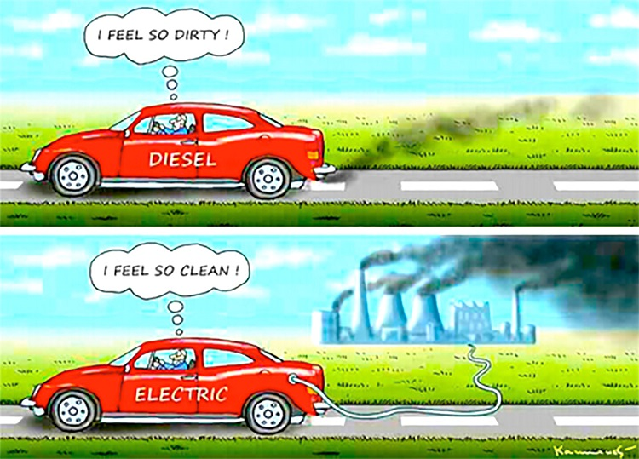

Slide 18
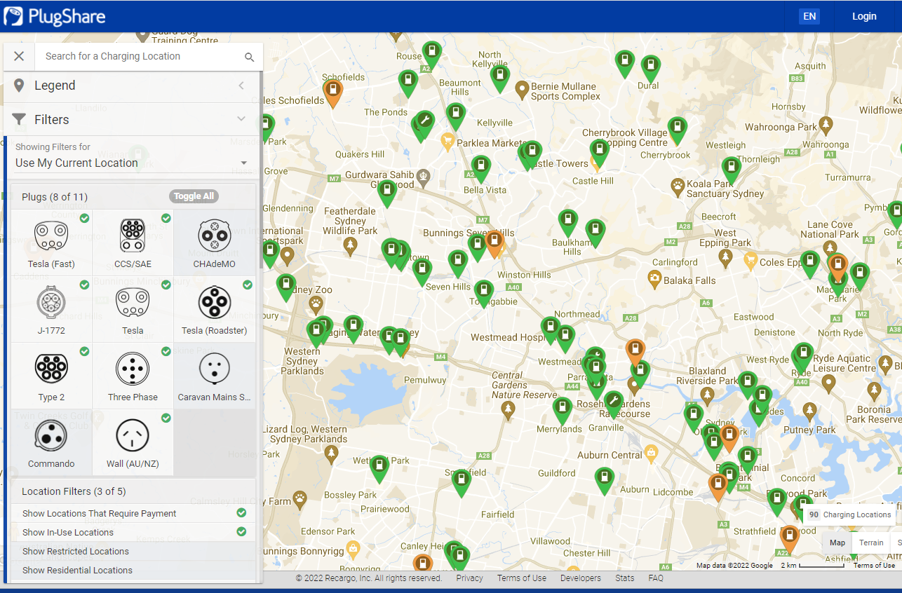
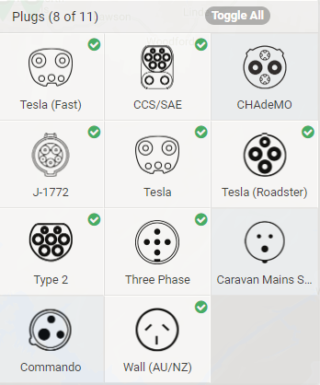
Charging Plugs - Australia
www.plugshare.com

Slide 19
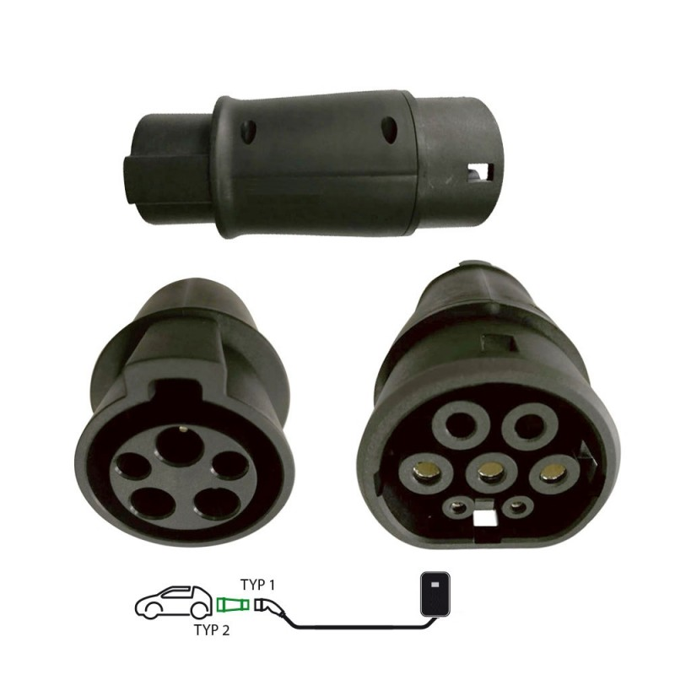
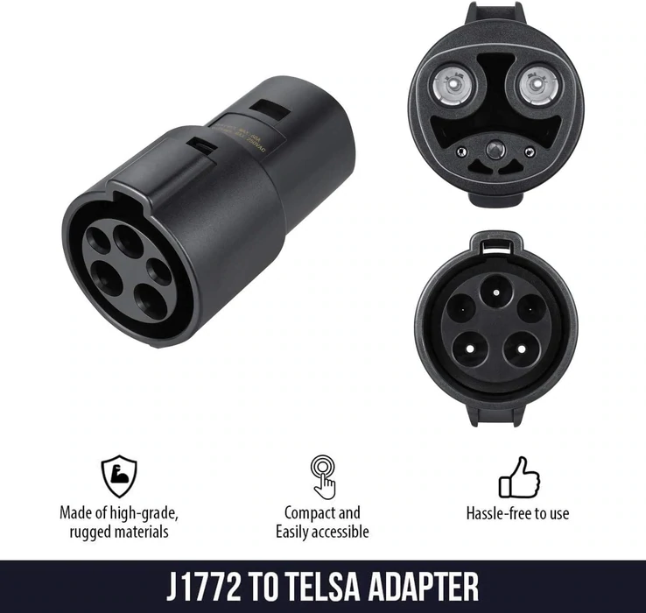
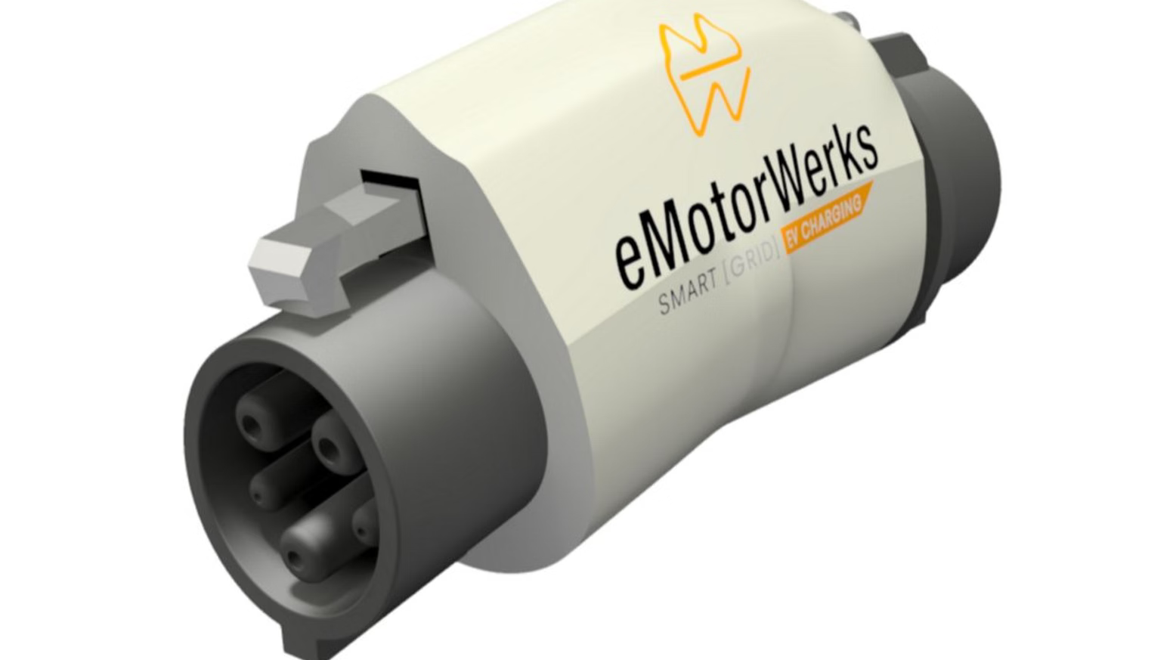
Charging Plugs - Adapters

Slide 21
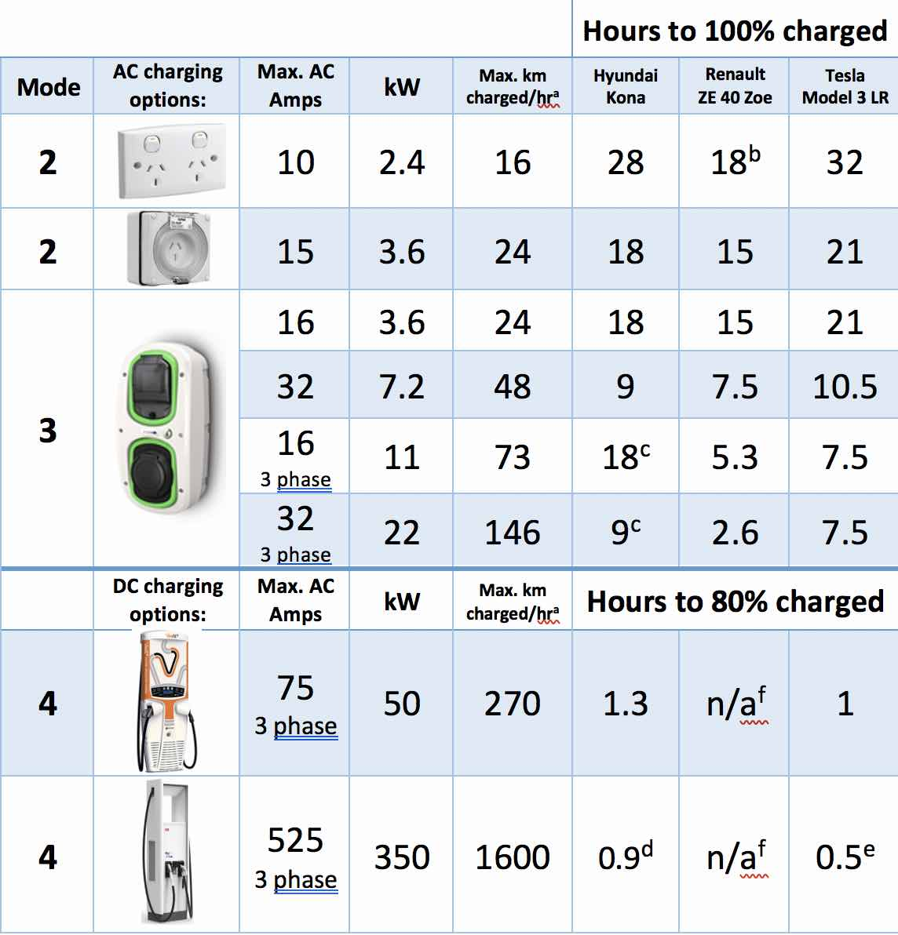
Charging times
~ $17.50 to charge
(22.96 ¢ / kWh)
$26.60 - $9.98
Peak 35.20¢/kWh
Off-peak 13.20¢/kWh
Notes:
Wagga Wagga to Sydney 450Km

Slide 22
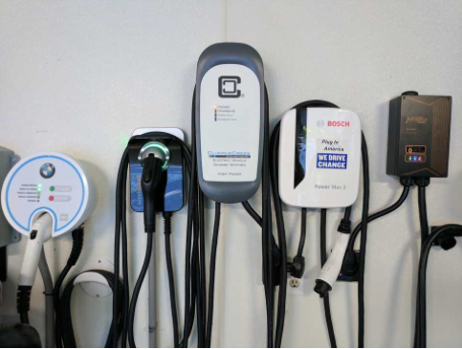
EVSE – Electric Vehicle Supply Equipment - Costs
Basic - Connect to single phase
Top EVSE - Monitor PV panel output - 3 phase
Wall mounted EVSEs $900 - $3000 for the unit.
Installation - $700 - $2000

Slide 23
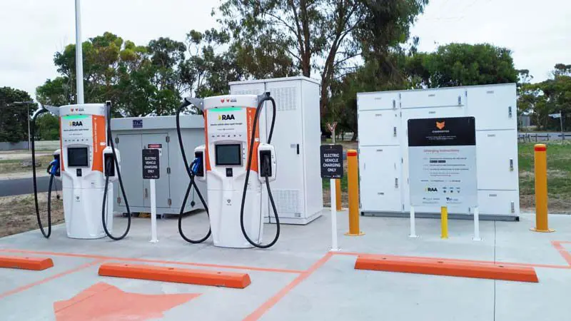
Fast DC Charging Station

Slide 24
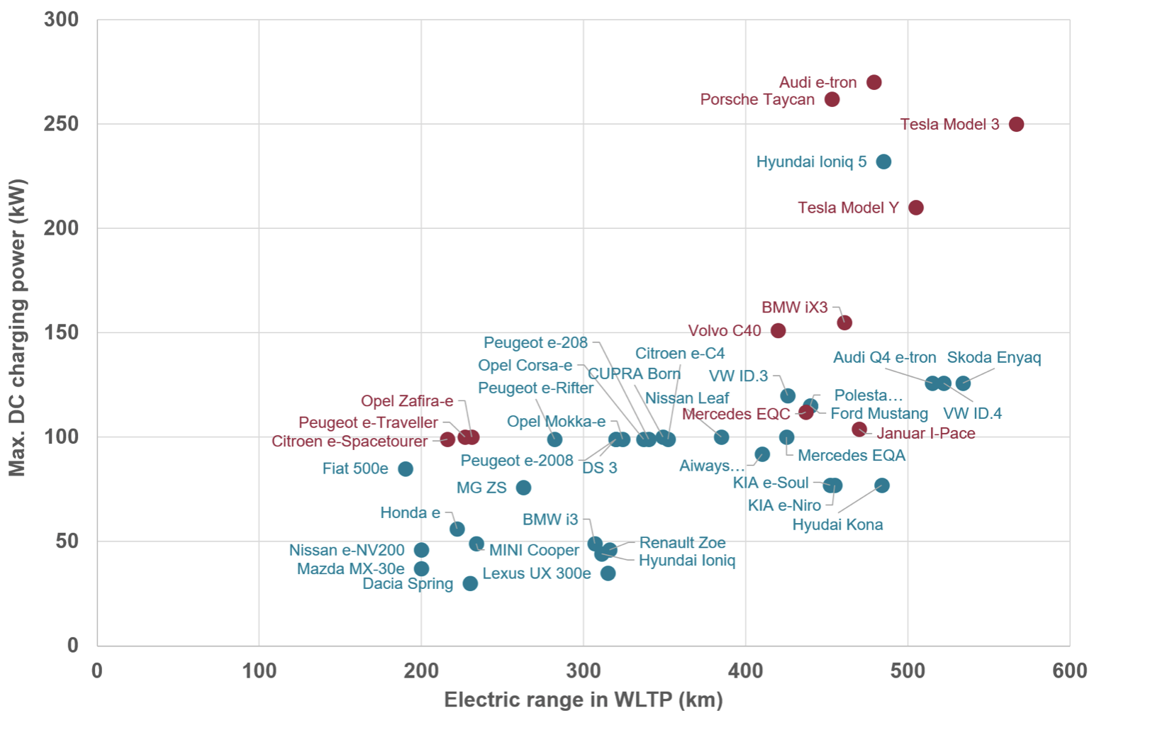
Charging & Range
Notes:
“Worldwide harmonized Light-duty vehicles Test Procedure” (WLTP)

Slide 25
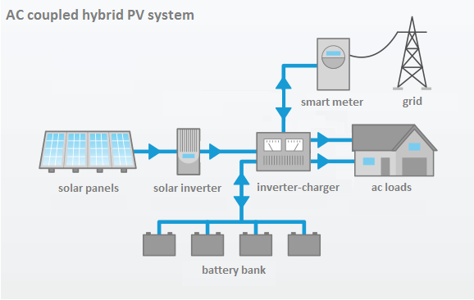
V2G Technology
By 2025, all new EVs will be V2G capable (ABC news 10 Aug 2021)
V2G / V2H chargers approved for Australia Upto $1,300 saving (ABC news 14 Feb 2022)
$10,000 (reportedly) for the Wallbox Quasar. (www.solarquotes.com.au 16/2/2022)

Slide 26
Batteries
A dry boring subject

Slide 27
'Battery technology is the main differentiator,' Nissan COO says (Yahoo Finance - 18 Feb 2022)
Ashwani Gupta

Slide 28
Bragging rights
I’ve got a supercharged V8
I’ve got a 4680 battery pack

Slide 29
Battery Types - Where the development interest is
Development chasing the following:
Fast charge,
temperature operating window (-50°C up to 125°C),
very low self-discharge,
longer lifetime and cycling performances,
higher energy density,
lower weight,
lower cost
Notes:
Fast charge,
temperature operating window (-50°C up to 125°C),
very low self-discharge,
very long lifetime and cycling performances,
higher energy density,
lower weight, etc

Slide 30
Battery Types - Where the development interest is
On the horizon battery types
Lithium Ion - Current technology
Lithium Ion - New generation Graphite, graphite/silicon or lithiated titanium oxides (- Cadmium [rare], Cobalt [rare], Nickel)
Lithium Ion/metal - Solid State 2.5 times more energy, 80% charge within 12 minutes
Lithium/Silicon - Sulphur Cells 3 times more energy, could cost almost 30% to 50% less

Slide 31
Many other battery types being developed
Sodium Ion
Lithium Metal
Supercapacitors
Aluminium Air
Zinc Air
Gold nanowire batteries
Graphene batteries (Gabat)
Copper foam batteries (Samsung)
Silver-carbon solid state
Liquid Air
Liquid Metal
Metal Air (Rust battery)
Flow batteries
etc..
Notes:
Ground breaking discovery
Amazing break-through

Slide 32
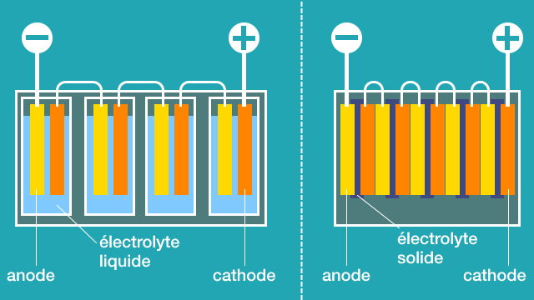
2. Lithium Ion/metal - Solid State

Slide 33
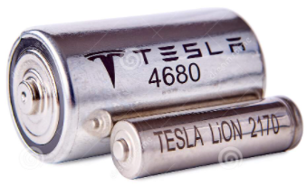
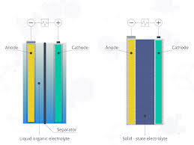
Battery Types - When? (Should I wait?)
1. Lithium Ion - New generation Graphite, graphite/silicon or lithiated titanium oxides (- Cadmium [rare earth], Cobalt [rare earth], Nickel) Tesla is producing 4680 battery now (3/2/2022). Batteries not yet in cars
2. Lithium Ion/metal - Solid State Some on the road prototypes Massive investment - eg. Panasonic/Toyota US$13.6 Billion,
3. Lithium/Silicon - Sulphur ?
Notes:
2170 vs 4680 cells = 4416 vs 960 quantity in pack
“pilot production facility” in Fremont and deploying large-scale production at other factories, including Gigafactory Texas and Gigafactory Berlin.

Slide 34
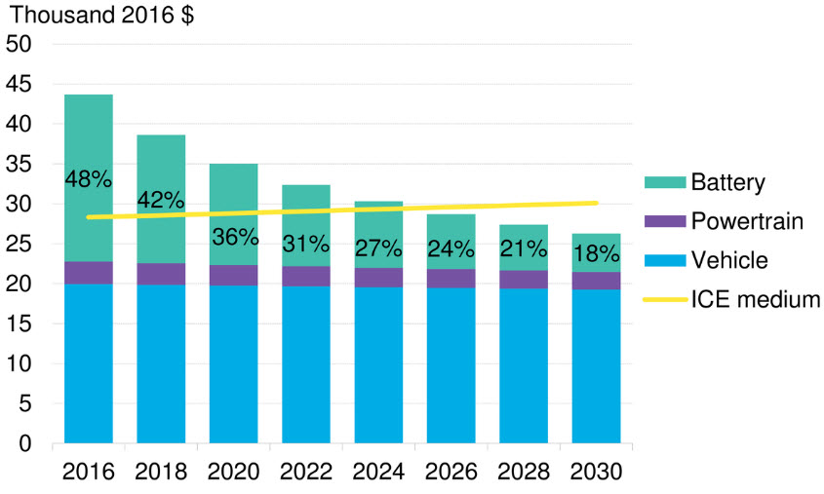
ICEV / BEV Price parity
US$100/kWh battery cost
Bloomberg

Slide 35
Running Costs

Slide 36
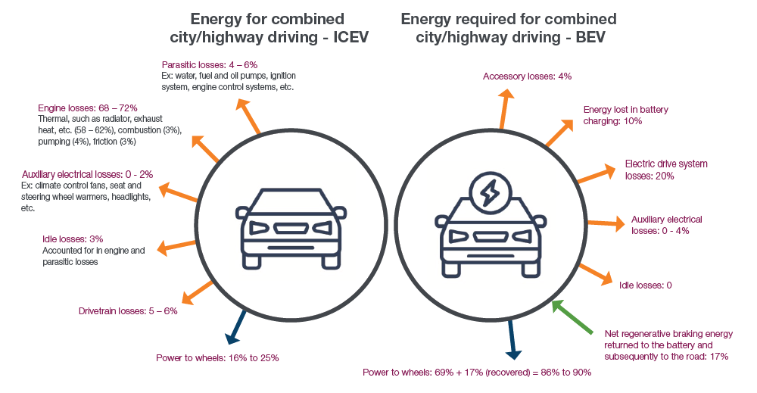
Notes:
ICE 30% efficient - 20% to the wheels
EV 80% efficient + 17% regen - 88% to the wheels

Slide 37
‘Fuel’ Cost / 100 km
21% vs 88% = 4.2 times more energy efficient
$18.00 / 100 km vs $4.00 / 100 km (Home charging)
NSW RUC - 1 July 2027 or 30% EV - 2.5¢ / km ($2.50 / 100 km)
$18.00 / 100 km vs $6.50 / 100 km
Peak 35.20c/kWh Off-peak 13.20c/kWh

Slide 38
Maintenance

Slide 39
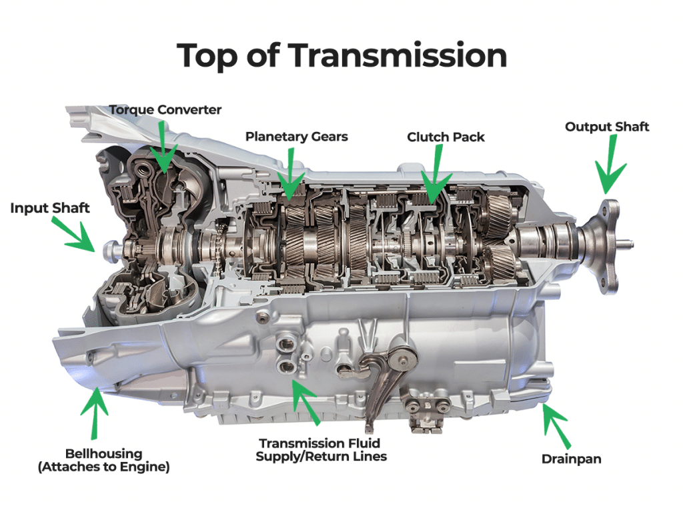
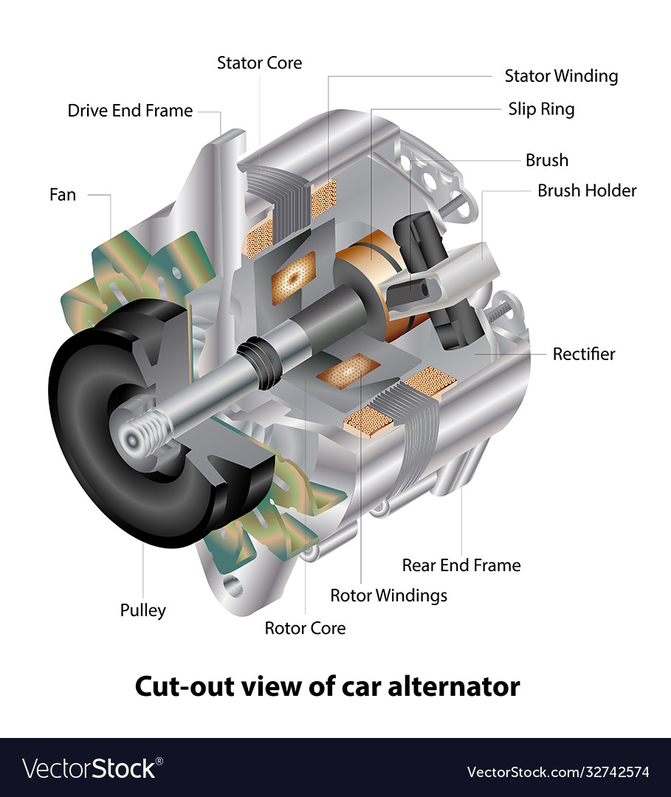
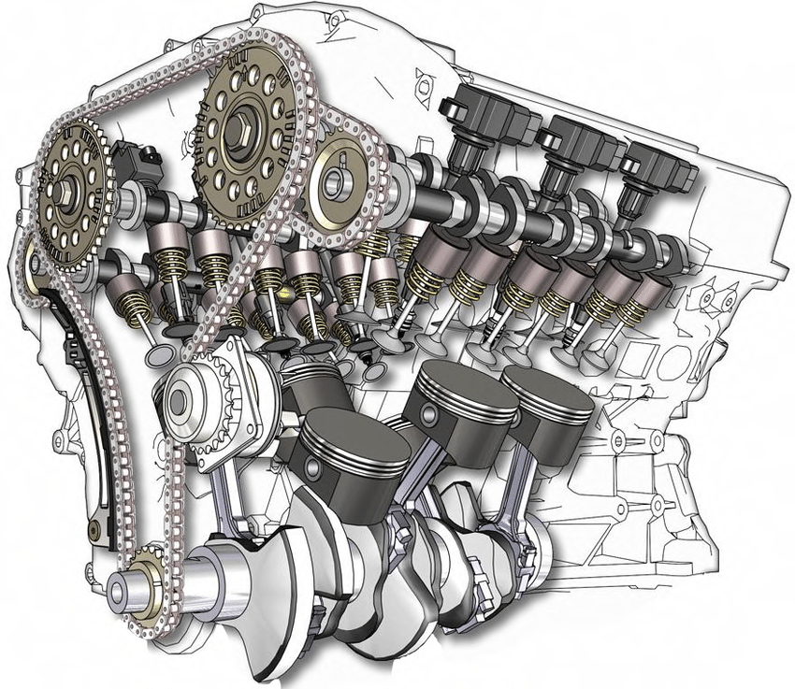
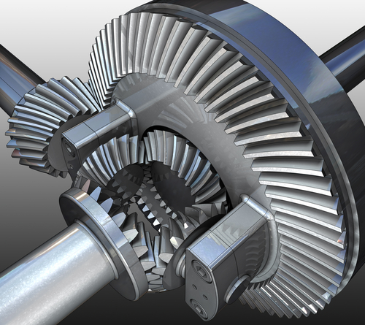
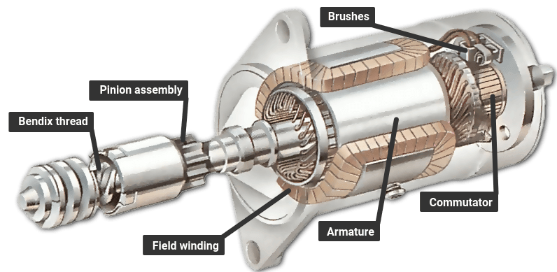
ICE Vehicle Drive Train

Slide 40
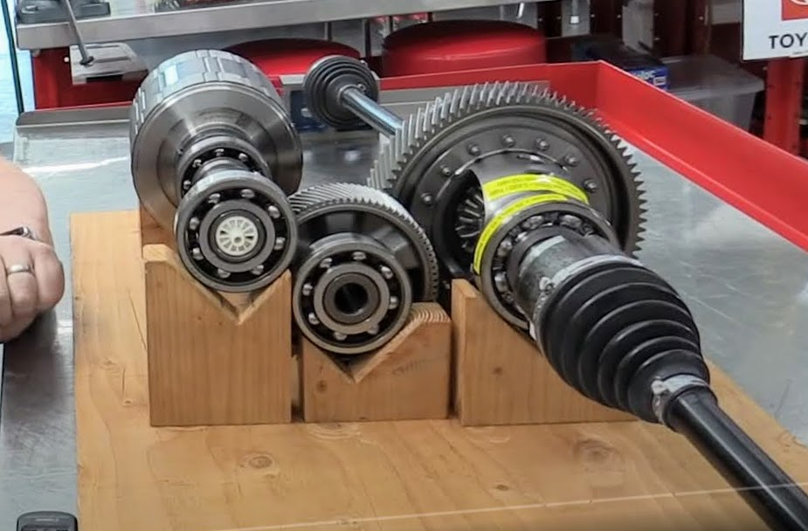
Complete Drivetrain - Tesla

Slide 41
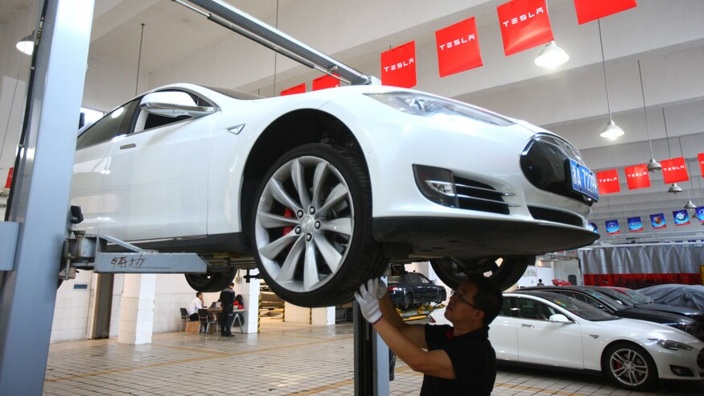
Maintenance
Compared to an ICE vehicle Relatively few moving parts
Tesla Service Plan:
Cabin Air Filter 3 Years
High Efficiency Particulate Air (HEPA) Filter (if fitted) 3 years
Air conditioning desiccant bag 3 years
Tire Rotation, Balance and Wheel Alignment 10,000 kms
Brake Fluid Test for contaminants 2 years
Brakes Regenerative braking
EV Maintenance Cost Is 40% Lower Than ICE (InsideEvs.com - 17/8/2021)
DANGER - Upto 800V charging 300-400V AC Motor

Slide 42
To Conclude

Slide 43
Summary
2025 - 2030 Most manufactures will only produce EVs.
2025 - Price parity.
2030 - Cheaper.
Much cheaper to run and maintain.
Battery development ?????

Slide 44
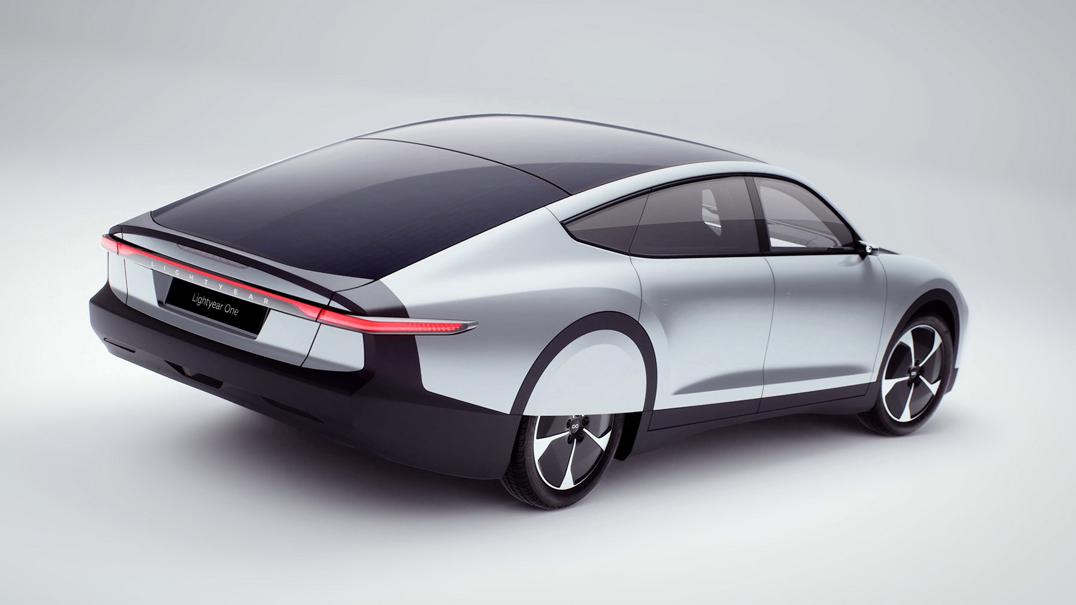
Lightyear One - 725 km (normal) 400 km (130 km/hr)

Slide 45
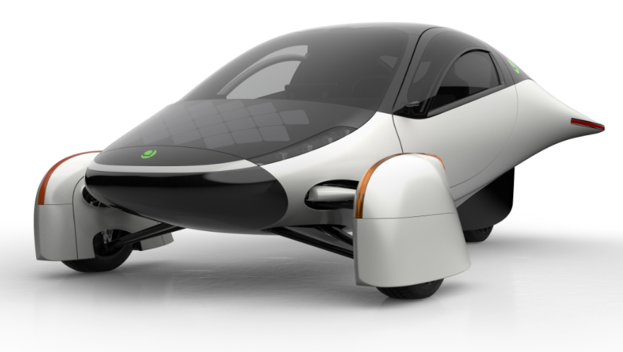
Aptera - 1600 km

Slide 46
Questions
Performance?
Fires?
Hydrogen Vehicles?
Towing ability?

Slide 47
https://www.lifehacker.com.au/2021/06/electric-vehicle-australia/
https://www.youtube.com/watch?v=SRUrB7ruh-8&t=936s
https://www.solarreviews.com/blog/where-to-find-electric-car-charging-stations-and-more
https://thedriven.io/2021/12/22/charged-up-ready-to-go-how-it-is-to-buy-an-electric-car-these-days/
https://thedriven.io/2021/12/21/thinking-of-buying-an-electric-car-heres-your-essential-ev-holiday-reading/
https://cleantechnica.com/2021/11/27/electric-car-faqs-do-evs-all-use-the-same-plug/amp/
https://thedriven.io/2021/11/26/affordable-electric-cars-are-out-there-but-when-will-they-be-here/
https://thedriven.io/2021/11/23/greek-island-debuts-what-must-be-worlds-slowest-electric-police-cars/
https://thedriven.io/2021/11/16/electric-cars-could-one-day-power-your-house-heres-how-to-make-it-happen/
https://thedriven.io/2021/11/15/electric-cars-101-what-you-should-know-before-you-buy-an-ev/
https://thedriven.io/2021/08/23/the-australian-early-adopters-guide-to-the-electric-vehicle-transition/
https://www.abc.net.au/news/science/2021-08-10/v2g-vehicle-to-grid-pays-ev-owners-for-electricity/100353072

